Slide 1
PC613: Communication Skills
Sem I, MSc IT
Instructor: Dr. Jenson Joseph

Slide 2
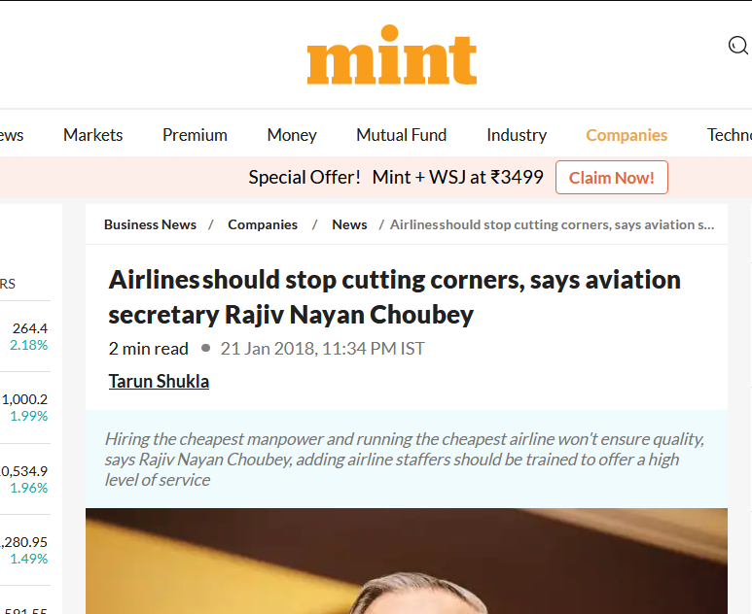
Learn an idiom
“to cut corners”

Slide 3
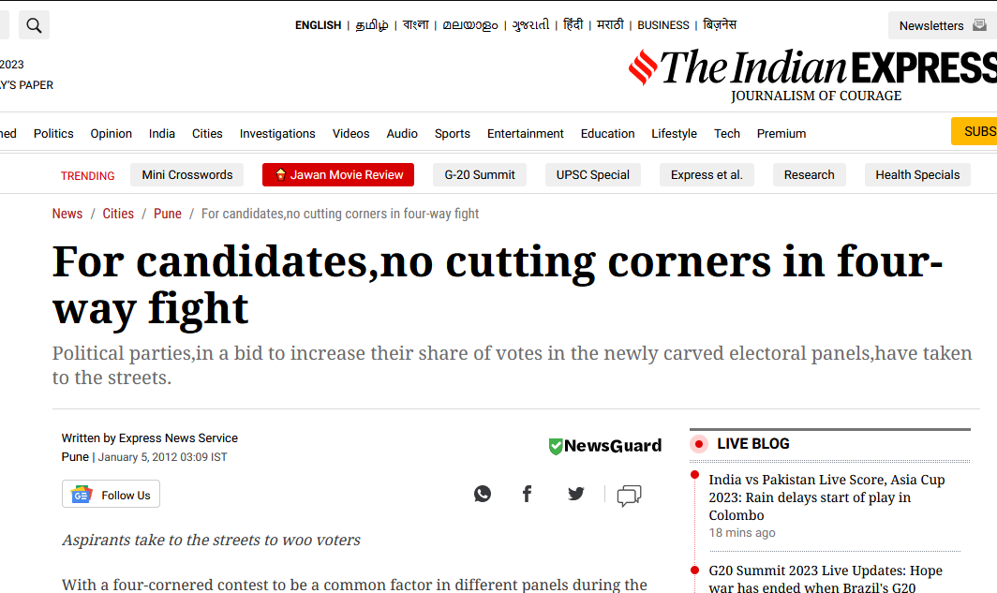
Learn an idiom
“to cut corners”

Slide 4
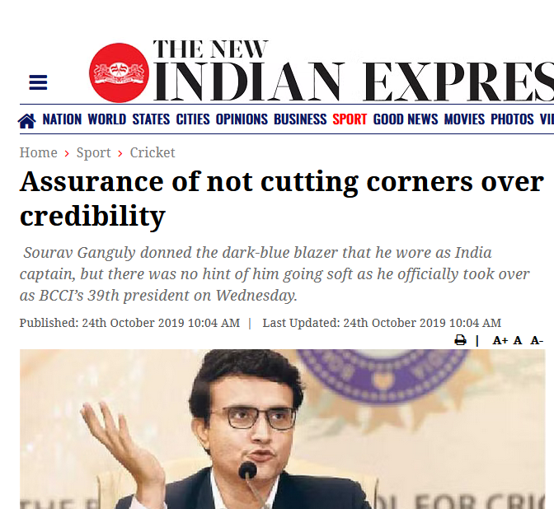
Learn an idiom
“to cut corners”

Slide 5

Learn an idiom
“to cut corners”

Slide 6
Learn an idiom
To cut corners means:
-- to save money or time when doing something by not including some parts, actions, or details, so that the result is not as good as it could be.
-- to perform some action in the quickest, easiest, or cheapest way.
Examples:
There were concerns that airport security staff under pressure might be tempted to cut corners.
Will speeding up nurses' training lead to improved patient care, or is it simply cutting corners?
The dictionary took nearly 70 years to complete because its makers refused to cut corners.

Slide 7
From the assignment
Correcting usages, grammar
Identify grammatical errors, and improper uses of phrases:
“The lyrics are about how much you try hard to do something and even get some achievements but you will always be trapped in yourself.”

Slide 8
From the assignment
Correcting usages, grammar
Identify grammatical errors, and improper uses of phrases:
“Lost in a daydream during class, I found myself in a reverie, far away from the classroom and immersed in my thoughts.”
Reverie -- Daydream; condition of being lost in thought.
Example: I was lost in reverie and didn't realize my flight was boarding until it was almost too late.

Slide 9
From the assignment
Correcting usages, grammar
Identify grammatical errors, and improper uses of phrases:
“All we did was plea in front of God at the time of surgery.”
He made a plea for help/mercy.
The president made a strong plea to Congress to vote on the health-care bill.

Slide 10
From the assignment
Correcting usages, grammar
Identify grammatical errors, and improper uses of phrases:
“A mom of a diseased child plead to people at the hospital to donate organ.”
He made a plea for help/mercy.
The president made a strong plea to Congress to vote on the health-care bill.

Slide 11
From the assignment
Correcting usages, grammar
Identify grammatical errors, and improper uses of phrases:
“It means by doing sins and unethical job we made our clothes dirty and it will not leave us till the end.”

Slide 12
From the assignment
Correcting usages, grammar
Identify grammatical errors, and improper uses of phrases:
“After he cracked his dream company he gorged on sundae icecreame.”

Slide 13
About the assignment
The assignment was called “Construct A Scenario”: Don’t try to make a blockbuster with multiple scenes, flashbacks, jump-cuts and so on. Just write a simple conversation set in ONE scenario.
Cut down on that sarcasm: let’s first learn to speak in simple direct language. Then try to write like Chetan Bhagat or Shakespeare or Kalidasa.

Slide 14
Self Intro
Luhar Karthik,
Bhavish Hiranandani
Shah Hetvi
Rathod Rajdeep Singh
Sosa Siddharth Kumar
Lakshya Jain
Hammad Farid
Rahul Kumar
Baghel Nitika
Ahire Prayag
Jaivik Rajeshbhai
Trivedi Pratham
Anjali Singh
Parthiv Zanje
Rupesh Singh
Mehta Khushi
Tarun Kumar

